Slide 1
Aliasing and Anti-Aliasing
Tu Changhe

Slide 2
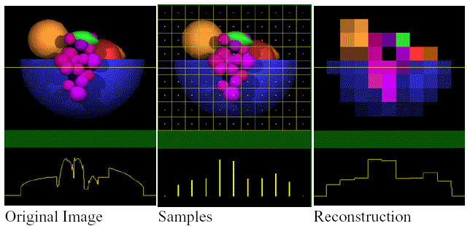
Examples of Aliasing

Slide 3
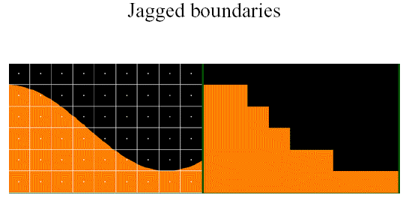
Examples of Aliasing

Slide 4
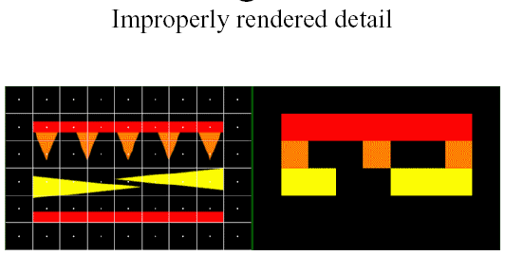
Examples of Aliasing

Slide 5
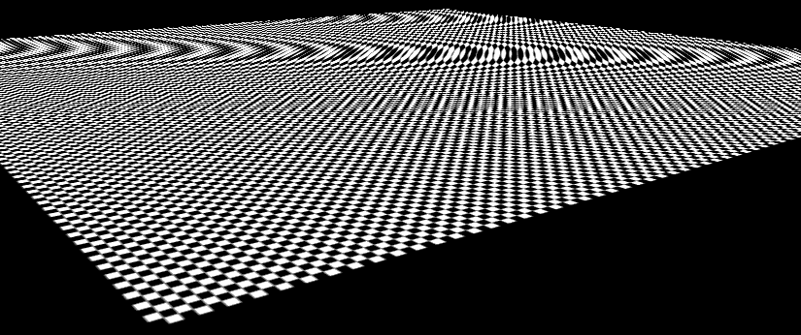
Examples of Aliasing
Texture Errors
point sampling

Slide 6
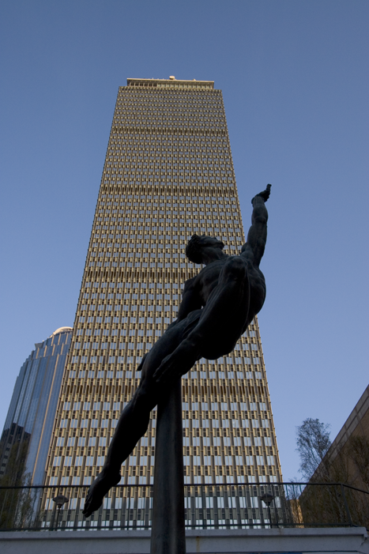
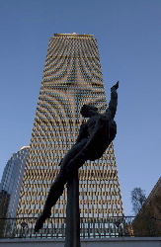
In photos too

Slide 7
Texture Minification
Remember texture minification
Texture mapped triangle
triangle small or far away
many texels land in a single pixel
Point-sample the texture?
i.e. take the texel at the center
misses lots of detail
causes “shimmering” or “buzzing”
especially noticeable of object or view moves
Solution was to filter
Texture buzzing is an example of aliasing
Filtering the texture is an example of antialiasing

Slide 8
Small Triangles
Aliasing when triangles very small
About the size of a pixel, or smaller
Scan conversion: point sampling
Pixel color due to triangle that hits center of pixel
Can miss triangles
Can have gaps if narrow triangle misses pixel centers
If view or object moves, can flicker as triangles cross pixel centers

Slide 9
Jaggies
Aliasing when drawing a diagonal on a square grid:
Stairstepping
Especially noticeable:
high-contrast edges
near horizontal or near vertical
As line rotates (in 2D)
steps change length
corners of steps slide along the edge
known as crawlies

Slide 10
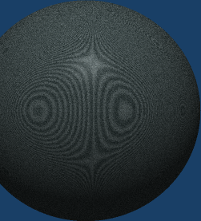
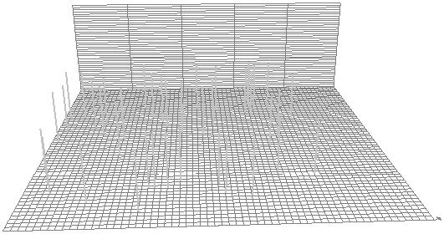
Moiré Patterns
Aliasing when rendering high detail regular patterns
can see concentric curve patterns
known as Moiré patterns
caused by interference between pattern and pixel grid
Also in real life: hold two window screens in front of each other

Slide 11
Strobing
Consider 30 frame-per-second animation of a spinning propeller
If the propeller is spinning at 1 rotation per second
each frame shows propeller rotated 12 degrees more than previous
looks OK
If the propeller is spinning at 30 rotations per second
each image shows propeller rotated 360 degrees
i.e. in same place as previous frame
i.e. propeller appears to stand still
If the propeller is spinning at
31 rotations per second: will appear to rotate slowly forwads
29 rotations per second: will appear to rotate slowly backwards
Example of strobing problems
temporal aliasing
caused by point-sampling the motion in time

Slide 12
Aliasing
These examples cover a wide range of problems…
… but they all result from essentially the same thing
The image we are making is trying to represent a continuous signal
The “true” image color is a function that varies with continuous X & Y (and time) values
For digital computation, our standard approach is to:
sample the original signal at discrete points (pixel centers or texels or wherever)
Use the samples to reconstruct a new signal, that we present to the audience
Want the audience to perceive the new signal the same as the original would be
Unfortunately, the sampling/reconstruction process causes some data to be misrepresented
Hence the term alias: some part of the signal masquerading as something else
Often refer to instances of problems as artifacts or aliasing artifacts
Antialiasing: trying to avoid aliasing problems. Three basic approaches:
Modify the original data so that it won’t have properties that cause aliasing
Use more sophisticated sampling/reconstruction techniques
Clean up the artifacts after-the-fact

Slide 13
Signal Analysis
Signal Analysis: the field that studies these problems in pure form
Applies also to digital audio, electrical engineering, radio, …
Artifacts are different, but the theory is the same
Includes a variety of mathematical and engineering methods for working with signals:
Fourier analysis, sampling theory, filter, digital signal processing (DSP), …
Kinds of signals:
electrical: a voltage changing over time. 1D signal: e = f(t)
audio: sound pressure changing over time. 1D signal: a = f(t)
computer graphics image: color changing over space. 2D signal: c=f(x,y)
computer graphics animation: color changing over space & time. 3D signal: c=f(x,y,t)
Examples and concepts typically shown for scalar 1D signal
but they extend to more dimensions for the signal parameters
but they extend to more dimensions for the signal value
A signal:

Slide 14
Sampling
Think of ideal image as perfect triangles in continuous (floating point) device space
Then we are thinking of our image as a continuous signal
Continuous image has infinite resolution
Edges of triangles are perfect straight lines
To render this image onto a regular grid of pixels:
We employ some sort of discrete sampling technique
Examine the original continuous image and sample it onto a finite resolution grid of pixels
If signal represents the red intensity of our virtual scene along some horizontal line, the sampled version consists of a row of discreet 8 bit red values
This is similar to what happens when a continuous analog sound signal is digitally sampled onto a CD

Slide 15
Reconstruction
Once we have our sampled signal, we then reconstruct it
In the case of computer graphics, this reconstruction takes place as a bunch of colored pixels on a monitor
In the case of CD audio, the reconstruction happens in a DAC (digital to analog converter) and then finally in the physical movements of the speaker itself

Slide 16
Reconstruction Filters
Filtering or filtration happens at the reconstruction phase:
raw sample data isn’t used as is
real world isn’t discrete
Some filtering due to the device, medium, and observer
Pixels of a monitor aren’t perfects squares or points of uniform color; they have some shape and distribution over space
The human eye filters so that a grid of pixels appears to be a continuous image
In audio, the loudspeaker has physical limitations on its movement
But we also introduce more filtering to help get the right result
In audio, digital processing or analog circuitry
In computer graphics, techniques such as bilinear or bicubic filtering

Slide 17
Low Frequency Signals
Original signal
Point sampled at relatively high frequency
Reconstructed signal

Slide 18
High Frequency Signals
Original signal
Point sampled at relatively low frequency
Reconstructed signal

Slide 19
Regular Signals
Original repeating signal
Point sampled at relatively low frequency
Reconstructed signal repeating at incorrect frequency (result frequency aliases the original frequency)

Slide 20
Nyquist Limit
Any signal can be considered as a sum of signals with varying frequencies
That’s what an equalizer or spectrum display on an audio device shows
In order to correctly reconstruct a signal whose highest frequency is x:
sampling rate must have frequency at least 2x
This is known as the Sampling Theorem
AKA Nyquist Sampling Theorem, AKA Nyquist-Shannon Sampling Theorem
The 2x sampling frequency is known as the Nyquist frequency or Nyquist limit
Frequencies below the Nyquist limit come through OK
Frequencies above the Nyquist limit come through as lower-frequency aliases, mixed in with the data

Slide 21
Nyquist Limit
In images, having high (spatial) frequencies means:
having lots of detail
having sharp edges
Basic way to avoid aliasing: choose sampling rate higher than Nyquist limit
This assumes we are doing idealized sampling and reconstruction
In practice, better to sample at least 4x
But in practice, we don’t always know the highest frequency
In fact, we might not have an upper limit!
E.g. checkerboard pattern receding to the horizon in perspective
Spatial frequency is infinite
Must use antialiasing techniques

Slide 22
Aliasing Problems, summary
Shimmering / Buzzing:
Rapid pixel color changes (flickering) caused by high detail textures or high detail geometry. Ultimately due to point sampling of high frequency color changes at low frequency pixel intervals
Stairstepping / Jaggies:
Noticeable stairstep edges on high contrast edges that are nearly horizontal or vertical. Due to point sampling of effectively infinite frequency color changes (step gradient at edge of triangle)
Moiré patterns:
Strange swimming patterns that show up on regular patterns. Due to sampling of regular patterns on a regular pixel grid
Strobing:
Incorrect or discontinuous motion in fast moving animated objects. Due to low frequency sampling of regular motion in regular time intervals. (temporal aliasing)

Slide 23
Antialiasing

Slide 24
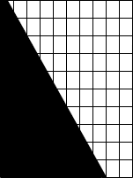
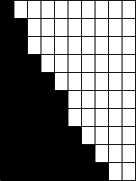

Aliasing

Slide 25
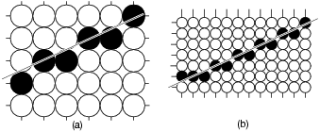
Increasing Resolution
Although the resulting picture looks better, the improvement comes at the price of quadrupling the memory cost, memory bandwidth, and scan-converting time.
Increasing resolution is an expensive solution that only diminishes the problem of jaggies – it does not eliminate the problem.

Slide 26

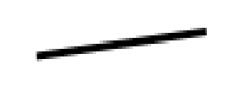
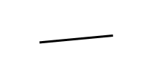
Illustration of aliasing

Slide 27
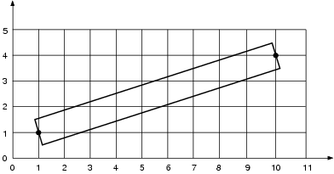
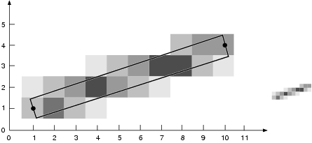
Unweighted Area Sampling
We think of any line as a rectangle of a desired thickness covering a portion of the grid.
We assume that a line contributes to each pixel’s intensity an amount proportional to the percentage of the pixel’s tile it covers.
We call the technique of setting intensity proportional to the amount of area covered unweighted area sampling.

Slide 28
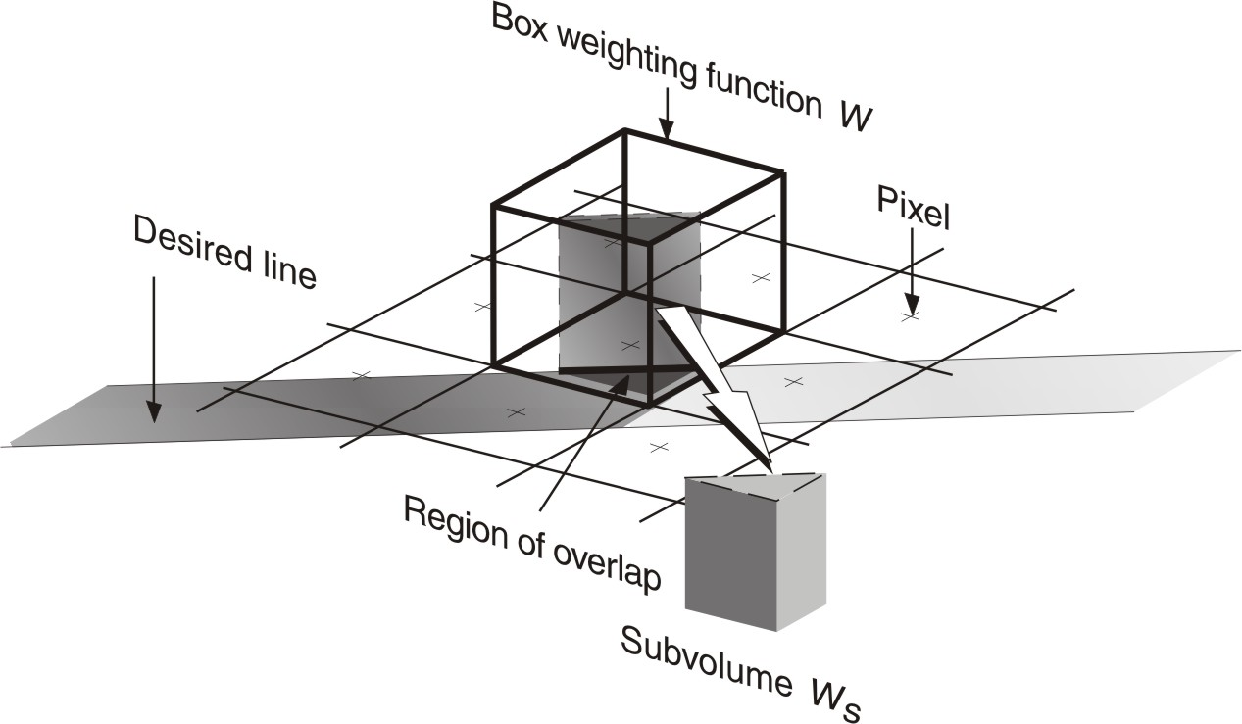
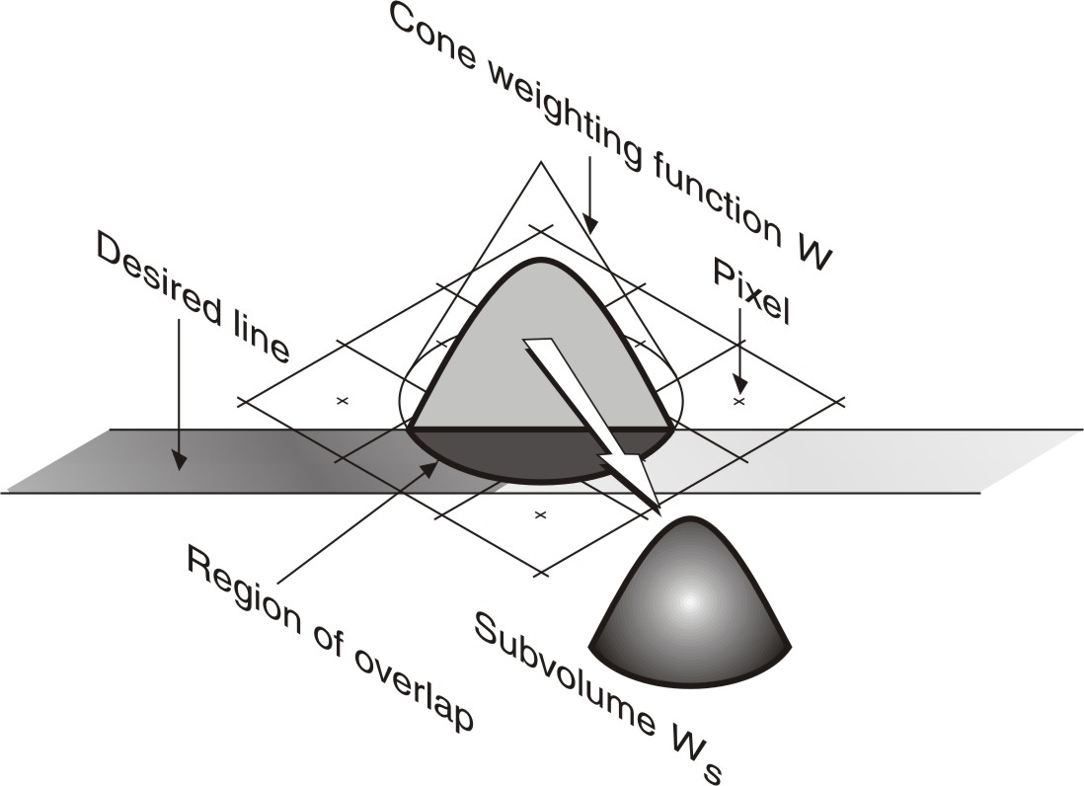
Weighted area sampling
From Unweighted
to weighted!
Define a weight function: W(x,y),
the weight Wa of an area A is the
integral of W(x,y) in A.
I = I_{max}*Wa.

Slide 29
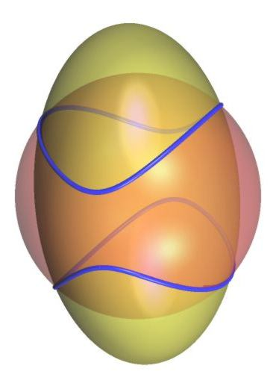
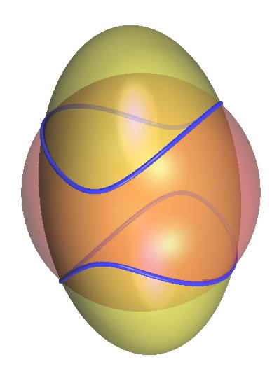

Slide 30
Sampling Filters
We could potentially use any one of several different sampling filters
Common options include the point, box, pyramid, cone, and Gaussian filters
Different filters will perform differently in different situations,
Best all-around sampling filters tend to be Gaussian in shape
The filters aren’t necessarily limited to cover only pixel.
Commonly extend slightly outside, overlapping with the neighboring pixels.
If filter covers less than the square pixel, will have problems like point sampling
Trying to strike a balance between:
Eliminating unwanted alias frequencies (antialiasing)
Eliminating wanted frequencies (blurring)

Slide 31
Edge Antialiasing

Slide 32
Pixel Coverage
Various antialiasing algorithms exist to color the pixel based on the exact area of the of the pixel that a triangle covers.
But, without storing a lot of additional information per pixel, very hard (or impossible) to properly handle case of several triangle edges in a single pixel
Impractical to make a coverage-based scheme compatible with z-buffering
Can do better if triangles are sorted back to front
Coverage approaches not generally used in practice for rendering
Still apply to things such as font filtering

Slide 33
Supersampling
A more popular method (although less elegant) is supersampling:
Point sample the pixel at several locations
Combine the results into the final pixel color
By sampling more times per pixel:
Raises the sampling rate
Raises the frequencies we can capture
Commonly use 16 or more samples per pixel
Requires frame buffer and z-buffer to be 16 times as large
Requires potentially 16 times as much work to generate image
A brute-force approach
But straightforward to implement
Very powerful

Slide 34
Uniform Sampling
Divide each pixel into a uniform grid of subpixels
Sample at the center of each subpixel
Generates better quality images than single point sampling
Filters out some higher-than-one-pixel frequency data
Nicely smooths lines and edges
But frequencies higher than Nyquist limit will still alias
Regular high-frequency signals will have Moiré patterns

Slide 35
Random Sampling
Supersample at several randomly located points
Breaks up repeating signals
Eliminates Moiré patterns
Instead of aliasing, frequencies greater than 1 pixel appear as noise in the image
Noise tends to be less objectionable to the viewer than jaggies or Moiré patterns
The human eye is pretty good at filtering out noise
But suffers from potential clustering and gaps
Result is not necessarily accurate
Too much noise.

Slide 36
Jittered Sampling
AKA stratified sampling,
Divide pixel into a grid of subpixels
Sample each subpixel at a random location
Combines the advantages of both uniform and random sampling
filters high frequencies
frequencies greater than subpixel sampling rate turned into noise
Commonly used

Slide 37
Reconstruction filter
Take average of all samples: box filter
Take weighted average of samples: other filters
weight according to a box, cone, pyramid, Gaussian, etc…
Can apply weighting to uniform, random, or jittered supersamples
little additional work

Slide 38
Weighted Distribution
Jittered supersampling with Gaussian filtering does well
Because of the filter weights, some samples have more influence on the image than others
e.g. with 16 samples, the 4 samples in the center can have higher total weight than the 12 others
But:
We’re paying same computational price for samples that don’t contribute much
We’re giving as much attention to the regions that don’t contribute much
Instead, adjust the distribution
Put more samples in the areas that contribute more highly
Get more accuracy for the same amount of work
known as Importance Sampling

Slide 39
Adaptive Sampling
More sophisticated option is to perform adaptive sampling
Start with a small number of samples
Analyze their statistical variation
It the colors are all similar, we accept that we have an accurate sampling
If the colors have a large variation, take more samples
continue until statistical error is within acceptable tolerance
Varying amount of work per pixel
Concentrates work where the image is “hard”
Tricky to add samples while keeping good distribution
But possible!
Used in practice, especially in research renderers

Slide 40
Semi-Jittered Sampling
Can apply a unique jittering pattern for each pixel (fully jittered) or re-use the pattern for all of the pixels (semi-jittered)
Both are used in practice
Semi-jittering advantages:
potential performance advantages
can preselect a good distribution
straight edges look cleaner
Semi-jittering disadvantages:
re-admits subtle Moiré patterns
because of semi-regularity of grid

Slide 41
Mipmapping & Pixel Antialiasing
Mipmapping and other texture filtering techniques reduce texture aliasing problems
Combine mipmapping with pixel supersampling
Choose mipmaps based on subpixel size
Gets better edge-on behavior than mipmapping alone
But it’s expensive to compute shading at every supersample
Hybrid approach:
Assume that mipmapping and filters in procedural shaders minimize aliasing at pixel scale
Compute only a single shading sample per pixel
Still supersample the scan-conversion and z-buffer
Gives edge antialiasing of supersampling and texture filtering of mipmapping
Doesn’t require cost of full supersampling
GPU hardware often does this:
Requires increase framebuffer/z-buffer memory
But doesn’t slow down performance much
Works pretty well

